Slide 1
Control Statements & Decision-Making in C

Slide 2
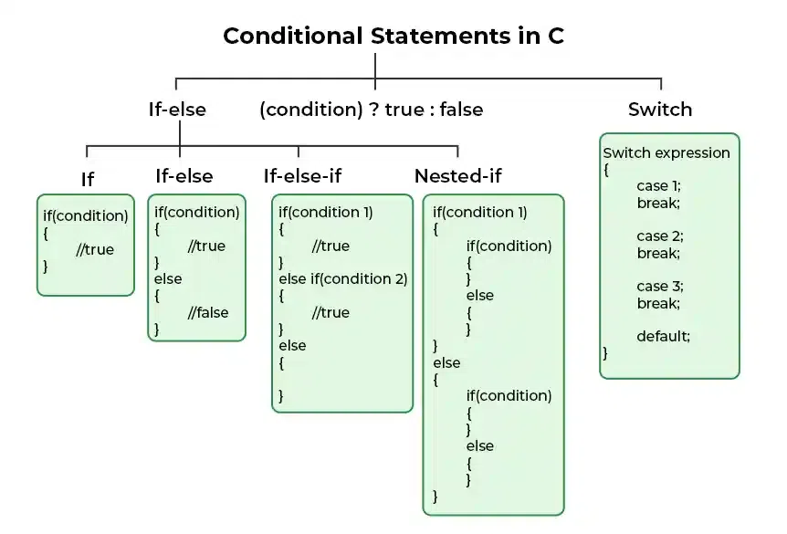
Decision Making in C (if , if..else, Nested if, if-else-if )

Slide 3
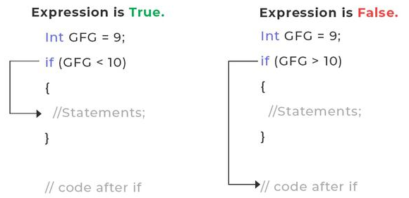
C – if Statement
// C Program to demonstrate the syntax of if statement
#include <stdio.h>
int main()
{
int gfg = 9;
// if statement with true condition
if (gfg < 10)
{
printf("%d is less than 10", gfg);
}
// if statement with false condition
if (gfg > 20) {
printf("%d is greater than 20", gfg);
}
}
output: 9 is less than 10
Syntax of if Statement in C
if(condition)
{
// if body
// Statements to execute if condition is true
}
How if in C works?

Slide 4
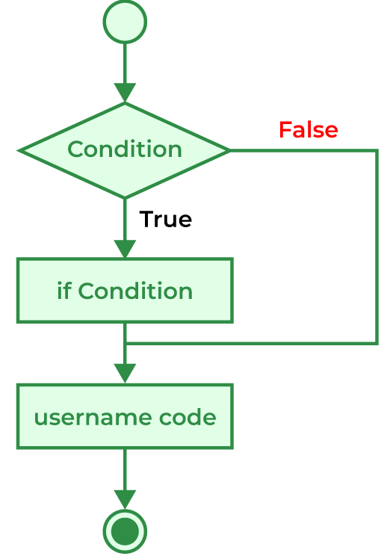
Flowchart of if in C
The working of the if statement in C is as follows:
STEP 1: When the program control comes to the if statement, the test expression is evaluated.
STEP 2A: If the condition is true, the statements inside the if block are executed.
STEP 2B: If the expression is false, the statements inside the if body are not executed.
STEP 3: Program control moves out of the if block and the code after the if block is executed.

Slide 5
Example 1: C Program to check whether the number is even or odd.
Example 2: C Program to check whether a number is prime or not.
// C program to check whether a number is prime or not
#include <math.h>
int main(){
int n = 19;
int flag = 0;
for (int i = 2; i * i <= n; i++) {
// If n is divisible by any number between
// 2 and n/2, it is not prime
if (n % i == 0) {
flag = 1;
break;
}
}
printf("%d is ", n);
if (flag == 1) {
// it is only printed if the number is not prime
printf("not ");
}
printf("a prime number.\n");
}
Output: 19 is a prime number.
// C Program to check if the number is even or odd
#include <stdio.h>
int main(){
int n = 4956;
// condition to check for even number
if (n % 2 == 0) {
printf("%d is Even", n);
}
// condition to check for odd number
else {
printf("%d is Odd", n);
}
}
Output: 4956 is Even

Slide 6
Can we specify multiple conditions in if statement?
We can specify multiple conditions in the if statement but not separately. We have to join these multiple conditions using logical operators making them into a single expression. We can then use this expression in the if statement.
Valid Expressions
if (a < b && a < c);
if (a == 25 || a < 25);
Invalid Expressions
if (a < b, a < c);

Slide 7
C if-else Statement
Syntax of if-else
if (condition) {
// code executed when the condition is true
}
else {
// code executed when the condition is false
}
How to use if-else in C?
// C Program to demonstrate the use of if-else statement
#include <stdio.h>
int main(){
// if block with condition at the start
if (5 < 10) {
// will be executed if the condition is true
printf("5 is less than 10.");
}
// else block after the if block
else {
// will be executed if the condition is false
printf("5 is greater that 10.");
}
}
Output: 5 is less than 10.
How if-else Statement works?
Working of the if-else statement in C is explained below:
When the program control first comes to the if-else block, the test condition is checked.
If the test condition is true:
The if block is executed.
If the test condition is false:
The else block is executed
After that, the program control continues to the statements below the if-else statement.

Slide 8
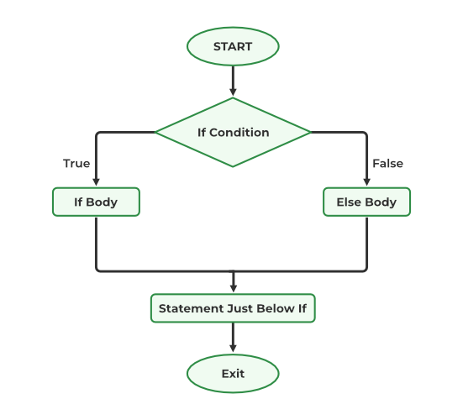
Flowchart of the if-else statement
Example 1: C Program to check whether a given number is even or odd
// C Program to Demonstrate the working of if-else statement
#include <stdio.h>
int main(){
// Some random number
int num = 9911234;
// checking the condition at the start of if block
if (num % 2 == 0) {
// executed when the number is even
printf("Number is even");
}
// else block
else {
// executed when the number is odd
printf("Number is Odd");
}
}
Output: Number is even

Slide 9
Example 2. C Program to check whether a person is eligible to vote or not.
Can we skip second braces{} around the body of the if-else block in C?
Answer:
We can skip the braces of the body of the if or else block as long as there is only a single statement inside their body. We will get an error if there is more than one statement in the body without braces.
#include <stdio.h>
int main(){
// declaring age of two person
int p1_age = 15;
int p2_age = 25;
// checking eligibility of person 1
if (p1_age < 18)
printf("Person 1 is not eligible to vote.\n");
else
printf("Person 1 is eligible to vote.\n");
// checking eligiblity of person 2
if (p2_age < 18)
printf("Person 2 is not eligible to vote.\n");
else
printf("Person 2 is eligible to vote.");
}
Output
Person 1 is not eligible to vote.
Person 2 is eligible to vote.

Slide 10
C If ... Else
C has the following conditional statements:
Use if to specify a block of code to be executed, if a specified condition is true
Use else to specify a block of code to be executed, if the same condition is false
Use else if to specify a new condition to test, if the first condition is false
Use switch to specify many alternative blocks of code to be executed
Conditions and If Statements
You have already learned that C supports the usual logical conditions from mathematics:
Less than: a < b
Less than or equal to: a <= b
Greater than: a > b
Greater than or equal to: a >= b
Equal to a == b
Not Equal to: a != b
You can use these conditions to perform different actions for different decisions.
The if Statement
Use the if statement to specify a block of code to be executed if a condition is true.
Syntax
if (condition) {
// block of code to be executed if the condition is true
}
Note that if is in lowercase letters. Uppercase letters (If or IF) will generate an error.

Slide 11
In the example below, we test two values to find out if 20 is greater than 18. If the condition is true, print some text:
Example
if (20 > 18) {
printf("20 is greater than 18");
}
The else Statement
Use the else statement to specify a block of code to be executed if the condition is false.
Syntax
if (condition) {
// block of code to be executed if the condition is true
} else {
// block of code to be executed if the condition is false
}
We can also test variables:
Example
int x = 20;
int y = 18;
if (x > y) {
printf("x is greater than y");
}
Example explained
In the example above we use two variables, x and y, to test whether x is greater than y (using the > operator). As x is 20, and y is 18, and we know that 20 is greater than 18, we print to the screen that "x is greater than y".
Example
int time = 20; if (time < 18) { printf("Good day."); } else { printf("Good evening."); } // Outputs "Good evening."

Slide 12
Example explained
In the example above, time (20) is greater than 18, so the condition is false. Because of this, we move on to the else condition and print to the screen "Good evening". If the time was less than 18, the program would print "Good day".
The else if Statement
Use the else if statement to specify a new condition if the first condition is false.
Syntax
if (condition1) {
// block of code to be executed if condition1 is true
} else if (condition2) {
// block of code to be executed if the condition1 is false and condition2 is true
} else {
// block of code to be executed if the condition1 is false and condition2 is false
}

Slide 13
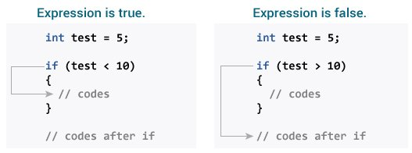
Example
int time = 22; if (time < 10) { printf("Good morning."); } else if (time < 20) { printf("Good day."); } else { printf("Good evening."); } // Outputs "Good evening."
Example explained
In the example above, time (22) is greater than 10, so the first condition is false. The next condition, in the else if statement, is also false, so we move on to the else condition since condition1 and condition2 is both false - and print to the screen "Good evening".
However, if the time was 14, our program would print "Good day."

Slide 14
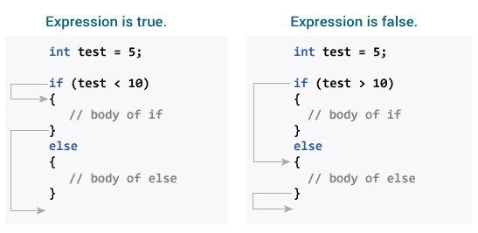
// Program to display a number if it is negative
#include <stdio.h>
int main() {
int number;
printf("Enter an integer: ");
scanf("%d", &number);
// true if number is less than 0
if (number < 0) {
printf("You entered %d.\n", number);
}
printf("The if statement is easy.");
return 0;
}

Slide 15
// Check whether an integer is odd or even
#include <stdio.h>
int main() {
int number;
printf("Enter an integer: ");
scanf("%d", &number);
// True if the remainder is 0
if (number%2 == 0) {
printf("%d is an even integer.",number);
}
else {
printf("%d is an odd integer.",number);
}
return 0;
}
// Program to relate two integers using =, > or < symbol
#include <stdio.h>
int main() {
int number1, number2;
printf("Enter two integers: ");
scanf("%d %d", &number1, &number2);
//checks if the two integers are equal.
if(number1 == number2) {
printf("Result: %d = %d",number1,number2);
}
//checks if number1 is greater than number2.
else if (number1 > number2) {
printf("Result: %d > %d", number1, number2);
}
//checks if both test expressions are false
else {
printf("Result: %d < %d",number1, number2);
}
}

Slide 16
Real-Life Examples
This example shows how you can use if..else to "open a door" if the user enters the correct code:
Example
int doorCode = 1337;
if (doorCode == 1337) {
printf("Correct code.\nThe door is now open.");
} else {
printf("Wrong code.\nThe door remains closed.");
}
This example shows how you can use if..else to find out if a number is positive or negative:
Example
int myNum = 10; // Is this a positive or negative number?
if (myNum > 0) {
printf("The value is a positive number.");
} else if (myNum < 0) {
printf("The value is a negative number.");
} else {
printf("The value is 0.");
}

Slide 17
Find out if a person is old enough to vote:
Example
int myAge = 25; int votingAge = 18; if (myAge >= votingAge) { printf("Old enough to vote!"); } else { printf("Not old enough to vote."); }
Find out if a number is even or odd:
Example
int myNum = 5; if (myNum % 2 == 0) { printf("%d is even.\n", myNum); } else { printf("%d is odd.\n", myNum); }

Slide 18
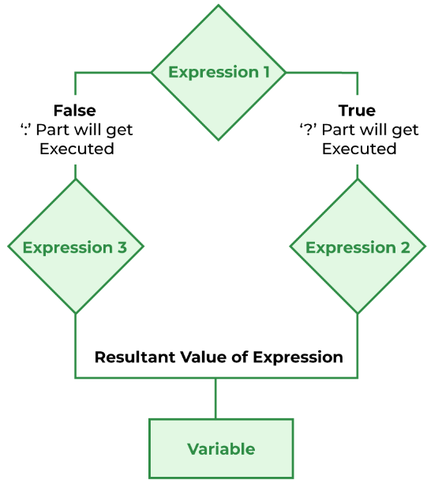
C Short Hand If Else / Conditional Operator
Short Hand If...Else (Ternary Operator)
There is also a short-hand if else, which is known as the ternary operator because it consists of three operands. It can be used to replace multiple lines of code with a single line. It is often used to replace simple if else statements:
Syntax
variable = (condition) ? expressionTrue : expressionFalse;
Example
int time = 20; if (time < 18) { printf("Good day."); } else { printf("Good evening."); }
Flowchart of Conditional Operator
Example
int time = 20; (time < 18) ? printf("Good day.") : printf("Good evening.");

Slide 19
// C Program to illustrate the use of conditional operator
#include <stdio.h>
int main() {
int var;
int flag = 0;
// using conditional operator to assign the value to var
// according to the value of flag
var = flag == 0 ? 25 : -25;
printf("Value of var when flag is 0: %d\n", var);
// changing the value of flag
flag = 1;
// again assigning the value to var using same statement
var = flag == 0 ? 25 : -25;
printf("Value of var when flag is NOT 0: %d", var);
}
Output:
Value of var when flag is 0: 25
Value of var when flag is NOT 0: -25

Slide 20
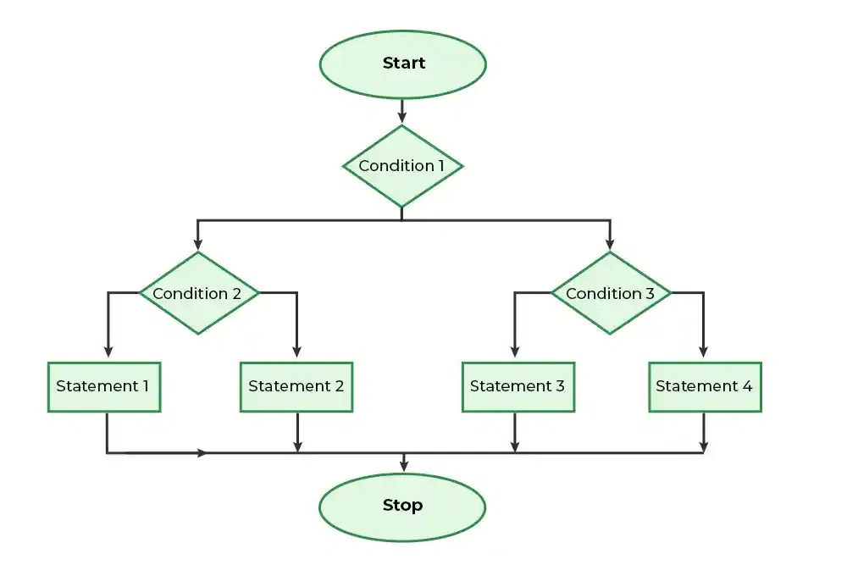
Nested if-else in C
Flowchart of Nested if-else
Syntax of Nested if-else
if (condition1)
{
// Executes when condition1 is true
if (condition2)
{
// Executes when condition2 is true
}
else
{
// Executes when condition2 is false
}
}

Slide 21
Nested if...else
// C program to illustrate nested-if statement
#include <stdio.h>
int main()
{
int i = 10;
if (i == 10) {
// First if statement
if (i < 15)
printf("i is smaller than 15\n");
// Nested - if statement
// Will only be executed if statement above
// is true
if (i < 12)
printf("i is smaller than 12 too\n");
else
printf("i is greater than 15");
}
}
Output
i is smaller than 15
i is smaller than 12 too
#include <stdio.h>
int main() {
int number1, number2;
printf("Enter two integers: ");
scanf("%d %d", &number1, &number2);
if (number1 >= number2) {
if (number1 == number2) {
printf("Result: %d = %d",number1,number2);
}
else {
printf("Result: %d > %d", number1, number2);
}
}
else {
printf("Result: %d < %d",number1, number2);
}
}

Slide 22
C if else if ladder
Working Flow of the if-else-if ladder:
The flow of the program falls into the if block.
The flow jumps to 1st Condition
1st Condition is tested respectively:
If the following Condition yields true, go to Step 4.
If the following Condition yields false, go to Step 5.
The present block is executed. Goto Step 7.
The flow jumps to Condition 2.
If the following Condition yields true, go to step 4.
If the following Condition yields false, go to Step 6.
The flow jumps to Condition 3.
If the following Condition yields true, go to step 4.
If the following Condition yields false, execute the else block. Goto Step 7.
Exits the if-else-if ladder.
Syntax:
// any if-else ladder starts with an if statement only
if(condition) {
}
else if(condition) {
// this else if will be executed when condition in if is false and
// the condition of this else if is true
}
.... // once if-else ladder can have multiple else if
else { // at the end we put else
}

Slide 23
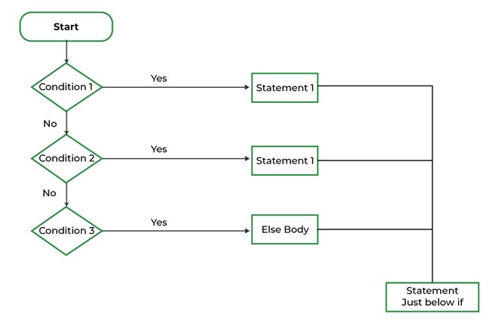
Flowchart of if-else-if Ladder
// C program to illustrate nested-if statement
#include <stdio.h>
int main() {
int i = 20;
if (i == 10)
printf("i is 10");
else if (i == 15)
printf("i is 15");
else if (i == 20)
printf("i is 20");
else
printf("i is not present");
}
Output: i is 20

Slide 24
Example 1: Check whether a number is positive, negative or 0
#include <stdio.h>
int main(){
int n = 0;
// all Positive numbers will make this
// condition true
if (n > 0) {
printf("Positive");
}
// all Negative numbers will make this
// condition true
else if (n < 0) {
printf("Negative");
}
// if a number is neither Positive nor Negative
else {
printf("Zero");
}
}
Output: Zero
Example 2: Calculate Grade According to marks
#include <stdio.h>
int main(){
int marks = 91;
if (marks <= 100 && marks >= 90)
printf("A+ Grade");
else if (marks < 90 && marks >= 80)
printf("A Grade");
else if (marks < 80 && marks >= 70)
printf("B Grade");
else if (marks < 70 && marks >= 60)
printf("C Grade");
else if (marks < 60 && marks >= 50)
printf("D Grade");
else
printf("F Failed");
return 0;
}
Output: A+ Grade

Slide 25
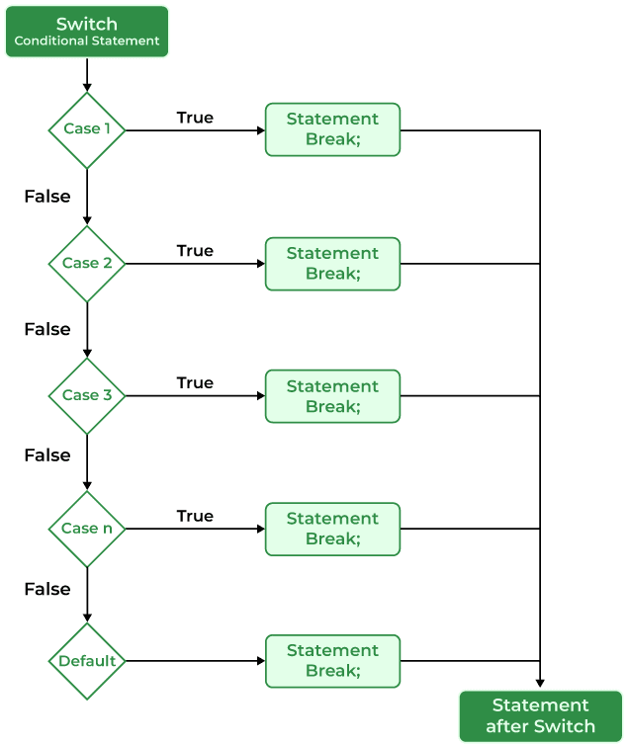
switch Statement in C
The switch case statement is an alternative to the if else if ladder that can be used to execute the conditional code based on the value of the variable specified in the switch statement. The switch block consists of cases to be executed based on the value of the switch variable.
Syntax of switch Statement in C
switch(expression)
{
case value1: statement_1;
break;
case value2: statement_2;
break;
.
.
.
case value_n: statement_n;
break;
default: default_statement;
}
Note: The switch expression should evaluate to either integer or character. It cannot evaluate any other data type.
Flowchart of switch

Slide 26
// C Program to illustrate the use of switch statement
#include <stdio.h>
int main()
{
// variable to be used in switch statement
int var = 2;
// declaring switch cases
switch (var) {
case 1:
printf("Case 1 is executed");
break;
case 2:
printf("Case 2 is executed");
break;
default:
printf("Default Case is executed");
break;
}
}
Output: Case 2 is executed
// C program to Demonstrate returning of day based numeric value
#include <stdio.h>
int main(){
int var = 1;
switch (var) {
case 1:
printf("Case 1 is Matched.");
break;
case 2:
printf("Case 2 is Matched.");
break;
case 3:
printf("Case 3 is Matched.");
break;
default:
printf("Default case is Matched.");
break;
}
}
Output: Case 1 is Matched.

Slide 27
Break in switch case
This keyword is used to stop the execution inside a switch block. It helps to terminate the switch block and break out of it. When a break statement is reached, the switch terminates, and the flow of control jumps to the next line following the switch statement.
The break statement is optional. If omitted, execution will continue on into the next case. The flow of control will fall through to subsequent cases until a break is reached.
// C Program to demonstrate the behaviour of switch case without break
#include <stdio.h>
int main()
{
int var = 2;
// switch case without break
switch (var) {
case 1:
printf("Case 1 is executed.\n");
case 2:
printf("Case 2 is executed.\n");
case 3:
printf("Case 3 is executed.");
case 4:
printf("Case 4 is executed.");
}
}
Output
Case 2 is executed.
Case 3 is executed.Case 4 is executed.
Default in switch case
The default keyword is used to specify the set of statements to execute if there is no case match.
It is optional to use the default keyword in a switch case. Even if the switch case statement does not have a default statement, it would run without any problem.

Slide 28
Important Points About Switch Case Statements
1. Switch expression should result in a constant value
If the expression provided in the switch statement does not result in a constant value, it would not be valid. Some valid expressions for switch case will be,
// Constant expressions allowed
switch(1+2+23)
switch(1*2+3%4)
// Variable expression are allowed provided
// they are assigned with fixed values
switch(a*b+c*d)
switch(a+b+c)
2. Expression value should be only of int or char type.
The switch statement can only evaluate the integer or character value. So the switch expression should return the values of type int or char only.
3. Case Values must be Unique
In the C switch statement, duplicate case values are not allowed.

Slide 29
4. Nesting of switch Statements
Nesting of switch statements is allowed, which means you can have switch statements inside another switch. However nested switch statements should be avoided as it makes the program more complex and less readable.
5. The default block can be placed anywhere
Regardless of its placement, the default case only gets executed if none of the other case conditions are met. So, putting it at the beginning, middle, or end doesn’t change the core logic.

Slide 30
Example 1: C Program to print the day of the week using a switch case.
#include <stdio.h>
int main(){
int day = 2;
printf("The day with number %d is ", day);
switch (day) {
case 1:
printf("Monday");
break;
case 2:
printf("Tuesday");
break;
case 3:
printf("Wednesday");
break;
case 4:
printf("Thursday");
break;
case 5:
printf("Friday");
break;
case 6:
printf("Saturday");
break;
case 7:
printf("Sunday");
break;
default:
printf("Invalid Input");
break;
}
}
Output: The day with number 2 is Tuesday

Slide 31
Example 2: Simple Calculator using switch case in C
#include <stdio.h>
#include <stdlib.h>
int main(){
char choice;
int x, y;
while (1) {
printf("Enter the Operator (+,-,*,/)\nEnter x to " "exit\n");
scanf(" %c", &choice);
if (choice == 'x') {
exit(0);
}
printf("Enter the two numbers: ");
scanf("%d %d", &x, &y);
switch (choice) {
case '+':
printf("%d + %d = %d\n", x, y, x + y);
break;
case '-':
printf("%d - %d = %d\n", x, y, x - y);
break;
case '*':
printf("%d * %d = %d\n", x, y, x * y);
break;
case '/':
printf("%d / %d = %d\n", x, y, x / y);
break;
default:
printf("Invalid Operator Input\n");
}
}
}

Slide 32
What are the differences between switch and if else if ladder in C?
switch | if else if
It executes the different cases on the basis of the value of the switch variable. | It executes the different blocks based on the condition specified.
It can only evaluate the int or char type expressions. | It can evaluate any type of expression.
Faster and easier to read for the large number of conditions. | It can get messy when there are lots of conditions.

Slide 41
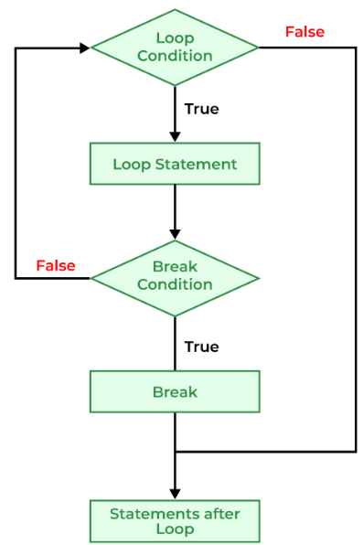
Jump Statements in C
These statements are used in C for the unconditional flow of control throughout the functions in a program. They support four types of jump statements:
A) break
This loop control statement is used to terminate the loop. As soon as the break statement is encountered from within a loop, the loop iterations stop there, and control returns from the loop immediately to the first statement after the loop.
Syntax of break
break;
Use of break in C
Simple Loops
Nested Loops
Infinite Loops
Switch case

Slide 42
// C Program to demonstrate infinite loop without using break statement
#include <stdio.h>
int main(){
int i = 0;
// while loop which will always be true
while (1) {
printf("%d ", i);
i++;
if (i == 5) {
break;
}
}
}
Output: 0 1 2 3 4
Break in C switch case
Syntax of break in switch case
switch(expression)
{
case value1:
statement_1;
break;
case value2:
statement_2;
break;
.....
.....
case value_n:
statement_n;
break;
default:
default statement;
}

Slide 43
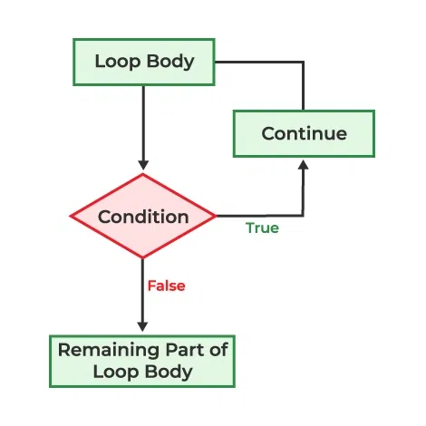
B) continue
This loop control statement is just like the break statement. The continue statement is opposite to that of the break statement, instead of terminating the loop, it forces to execute the next iteration of the loop.
As the name suggests the continue statement forces the loop to continue or execute the next iteration. When the continue statement is executed in the loop, the code inside the loop following the continue statement will be skipped and the next iteration of the loop will begin.
Syntax of continue
continue;
Flowchart of Continue
#include <stdio.h>
int main() {
// loop from 1 to 10
for (int i = 1; i <= 10; i++) {
if (i == 6)
continue;
else
printf("%d ", i);
}
}
Output
1 2 3 4 5 7 8 9 10
Use of continue in C
Single Loops
Nested Loops

Slide 44
What is the difference between break and continue?
break | continue
The break statement terminates the loop and brings the program control out of the loop. | The continue statement terminates only the current iteration and continues with the next iterations.
The syntax is: break; | The syntax is: continue;
The break can also be used in switch case. | Continue can only be used in loops.
What is the use of continue statement in C?
The continue statement in C is used in loops to skip the current iteration and move on to the next iteration without executing the statements below the continue in the loop body.

